Slide 1
LeetCode Questions
William McGuire

Slide 2
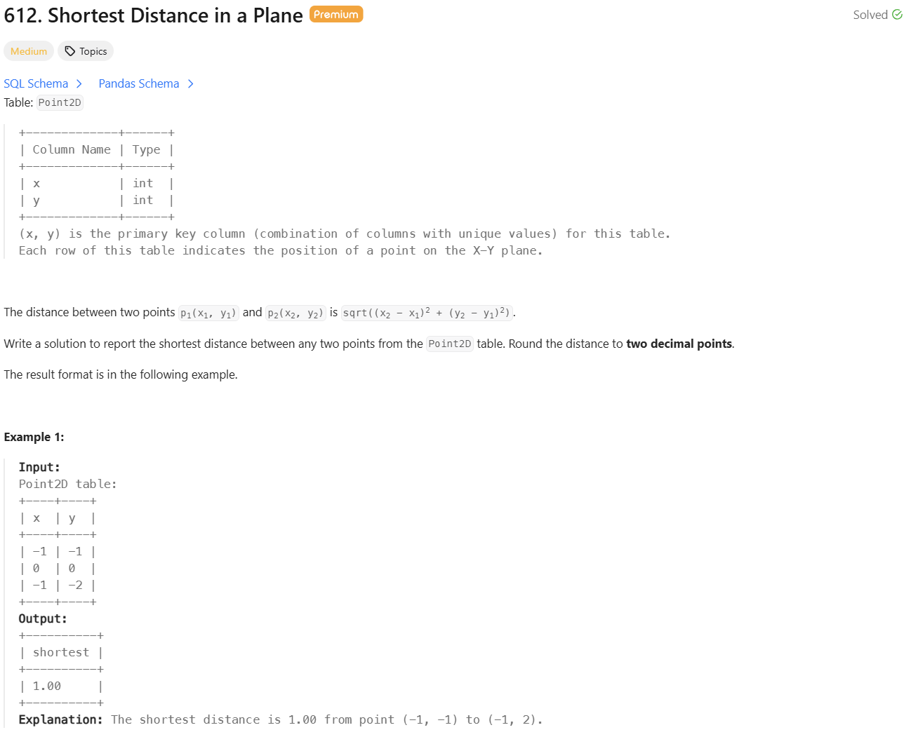

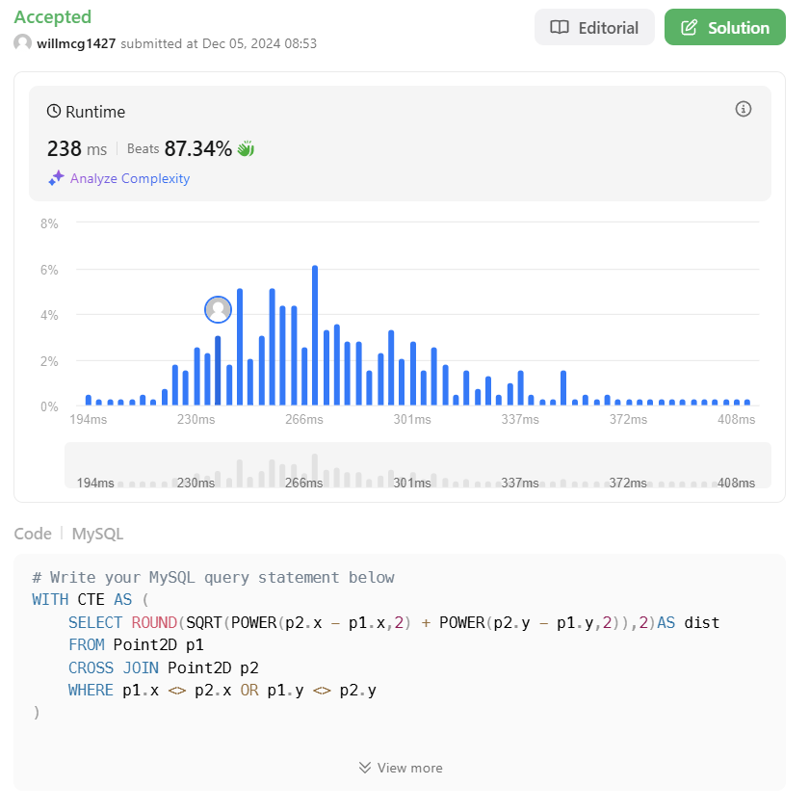

Slide 3
